Slide 1

Cutting Bus Routes through Hub and Spoke Model
IEMS 365: Analytics for Social Good | Team A4
February 9, 2017

Slide 2

Agenda
Transportation Models
Point to Point
Hub and Spoke
Clustering
Results
Costs
Going Forward

Slide 3

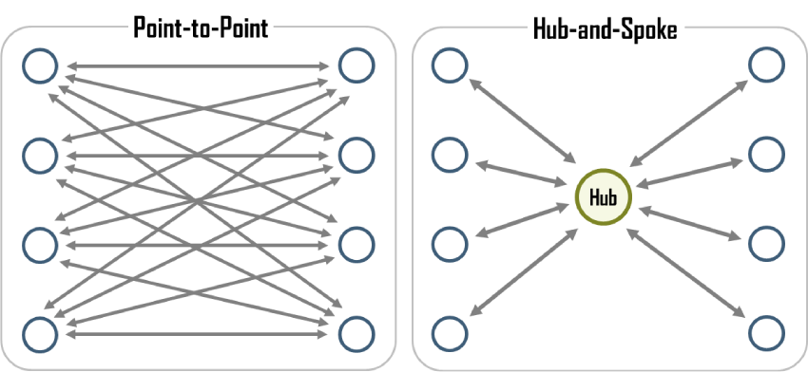
Big Idea: Transport Models

Slide 4

Proposal: Hub and Spoke
Notes:
Consider other school districts & examples as case studies

Slide 5



Case Studies
“Hub and Shuttle” model
Elgin, IL
“Hub” as nearest school/building
Pataskala, OH
“Hub” as neighborhood schools
Jacksonville, Florida

Slide 6

D65 Model: Point-to-point
Advantages
Eliminates need for connections
Reduces travel time
Reduces risk of children getting lost
Disadvantages
Economically inefficient
Notes:
Refers to a transportation system in which a plane, bus, or train travels directly to a destination, rather than going through a central hub.

Slide 7

New Model: Hub and Spoke
Advantages
Fewer Routes → Fewer Busses
Maximizes capacity
Scalable
Disadvantages
Students may need to transfer busses
Fairly inflexible routes
Further distances to bus stop for many students
Notes:
Make clear spokes are walking

Slide 8

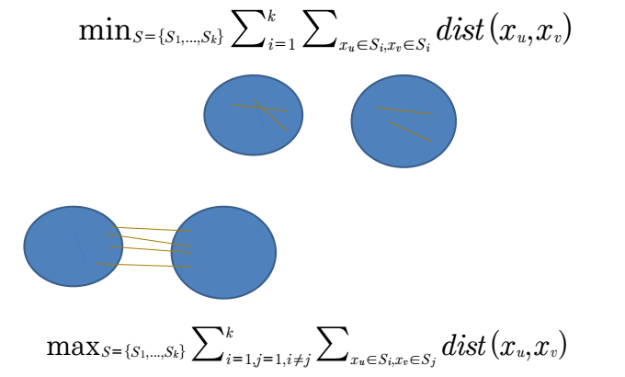
Clustering
Unsupervised learning
K-means clustering
Groups current bus stops
Hubs: Centers
Spokes: Walking
K-Means Citation: Andrew Ng’s Machine Learning Course, Coursera
Notes:
Credit for photo: Dr. Diego Klabjan’s IEMS 308 Data Analytics Class
Include citation for background research
Citation:

Slide 9

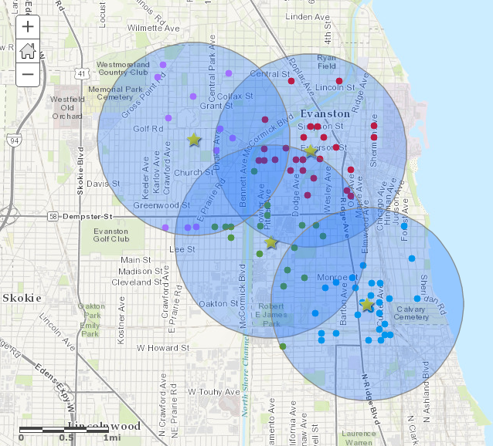
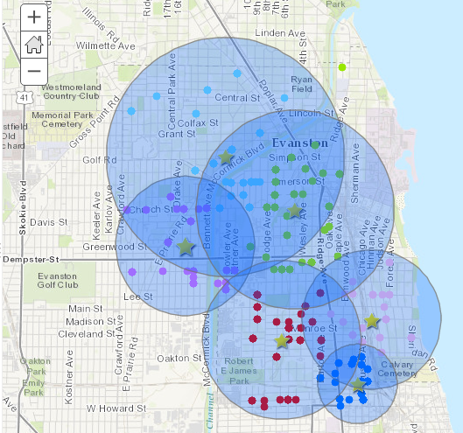
Results - Bessie Rhodes
King Labs
Bessie Rhodes

Slide 10

Cost Savings (Optimistic)
Cost of 1 Single Tier Bus: $229.82 Daily
Total Collective Yearly Saving: $80,896.64
Daily Cost and # of Busses | # Buses Currently | # Buses Hub and Shuttle | Cost Currently (Assuming Single Tier) | Cost Hub and Shuttle
Bessie Rhodes | 5 | 4 | $1,149.1 | $919.28
King Labs | 7 | 6 | $1,608.74 | $1,378.92
Notes:
Daily: PU and DO\
Assuming 176 days of school in IL
State all assumptiosn and put lower limit for saving in

Slide 11
Cost Savings (Conservative)
Cost of 1 Double Tier Bus: $252.00 Daily
Total Yearly Savings: $7,807.36
Daily Cost and # of Busses | # Buses Currently | # Buses Hub and Shuttle | Cost Currently (Assuming Two Tier) | Cost Hub and Shuttle
Bessie Rhodes | 5 | 4 (2 Tier) 1 (1 Tier) | $1,260 | $1,237.82
King Labs | 7 | 6 (2 Tier) 1 (1 Tier) | $1,764 | $1,741.82

Slide 12

Going Forward
Potential hazards
Spokes as busses
Hubs relocate year to year
Routing within clusters

Slide 13

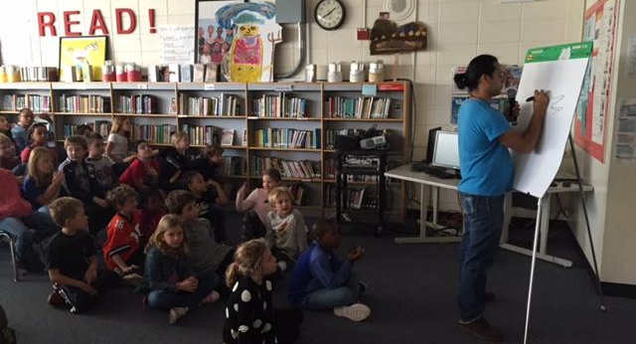
Questions?

